Slide 1
Requirement Engineering

Slide 2

WRSPM Model
(World, Requirements, Specification, Program, and Machine

Slide 3
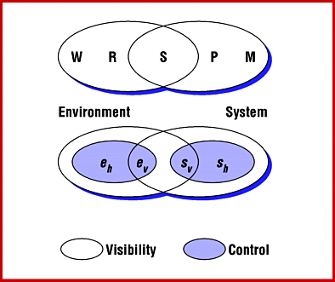
WRSPM Model
W – World
R – Requirements
S – Spesification
P – Program
M - Machine
𝑒_{ℎ} – hidden environmental
𝑒_{𝑣} – visible environmental
𝑠_{𝑣} – visible system
𝑠_{ℎ}– hidden system

Slide 4
WRSPM Model
World (W) : assumptions, that we know is true. It has impact on system and problem domain. Usually ‘we take it for granted’
Requirement (R): what is needed by users, solution expected by users
Specification (S): how the system satisfy requirements; what will the system do
Program (P): what will be written when the system is developed; in the form of source code to fulfill specifications
Machine (M): hardware specification

Slide 5
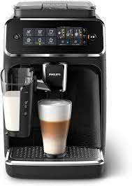
Example: Coffee Machine

Slide 6
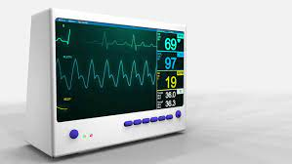
Patient Heartbeat Monitor
What if the domain assumptions are wrong?

Slide 7
Any issues?
What if the warning system notifies the nurse one week after the heartbeat stop?
Is this the system that we want?

Slide 8
Individual Assignment
Odd NRP
Analyse a Robot system
Create its WRSPM
Analyse its requirements (business, user, functional and non-functional with the metric used)
Even NRP
Analyse a Logistic system
Create its WRSPM
Analyse its requirements (business, user, functional and non-functional with the metric used)
Submit your report in pdf file with title NRP.pdf today before 18.00 WIB in the Classroom

Slide 9
Individual Assignment
Odd NRP
Analyse a Smart vacuum system
Create its WRSPM
Analyse its requirements (business, user, functional and non-functional with the metric used)
Even NRP
Analyse an e-commerce system
Create its WRSPM
Analyse its requirements (business, user, functional and non-functional with the metric used)
Submit your report in pdf file with title NRP.pdf today before 18.00 WIB in the Classroom

Slide 10
Group Assignment
Create a group consist of 4-5 students
Each group propose an expert or embedded system and analyse its WRSPM
Submit it to the Classroom before Monday, 27 Feb 2023 at 9:00 pm
Present it in the next week meeting

Slide 11
Thank You

